Slide 1
Evaluación y Logging en Aplicaciones de IA
Luis Mañez

Slide 2


Luis Mañez
Chief Architect – ClearPeople LTD
@luismanez
linkedin.com/in/luismanez

Slide 4
Logging

Slide 5
Semantic Kernel supports OpenTelemetry standard

Slide 6
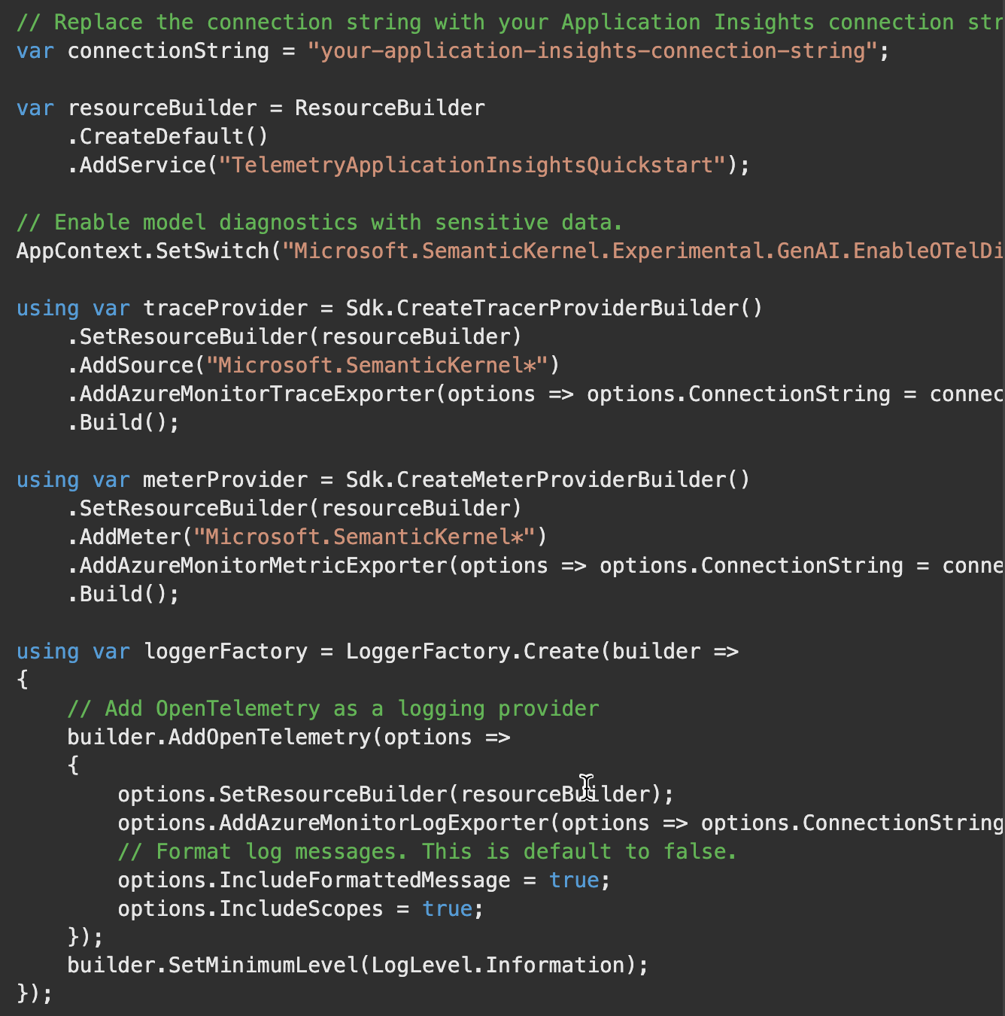

Slide 7
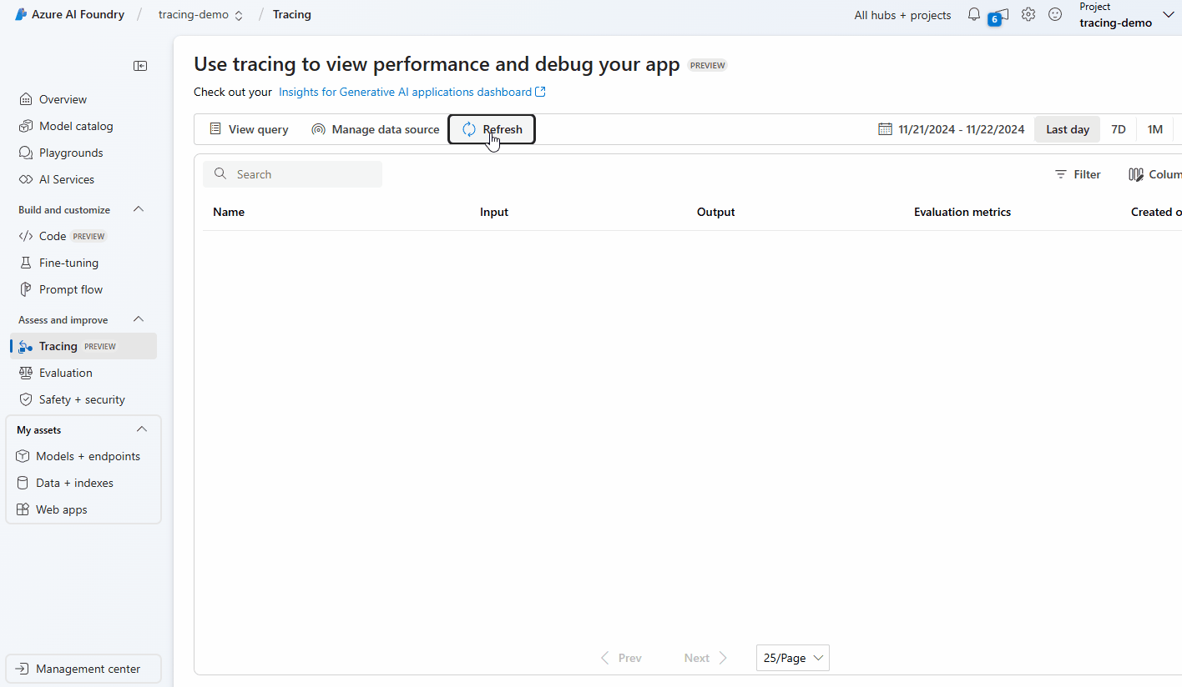

Slide 8
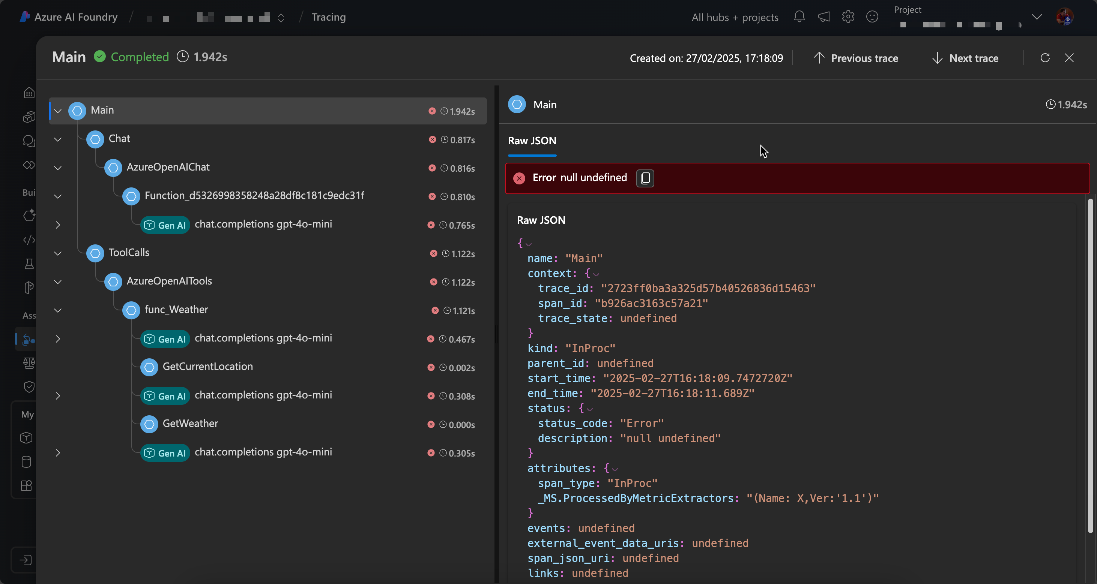

Slide 9
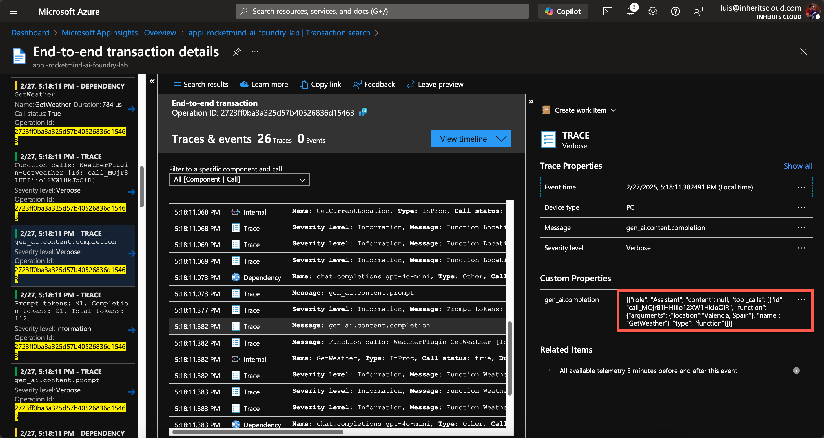

Slide 10
AI Evaluation

Slide 11

How good is our AI solution?
Is our RAG strategy working fine?
Can we use a cheaper model?

Slide 12


Slide 13








Evaluation Criterias
Relevance
Groundedness
Truth
Equivalence
Completeness
Coherence
Fluency

Slide 14
Evaluation Criterias
Relevance – Is the AI’s response useful and related to the question or context? Example: You ask about Azure OpenAI, but the AI responds about AWS SageMaker. → Poor relevance.
Coherence – Do the ideas in the response make sense together? Example: The AI says in one sentence that "generative AI does not need data" and in the next that "it requires millions of data points for training." → Poor coherence.
Truth – Is the information provided by the AI factually, correct? Example: You ask for the release date of .NET 8, and the AI gives you the wrong date. → Poor truthfulness.
Equivalence – Do two different responses mean the same thing, even if phrased differently? Example:
Response 1: "Azure OpenAI is a service that allows you to use OpenAI models in Microsoft’s cloud."
Response 2: "Azure OpenAI provides access to OpenAI’s AI models through Microsoft’s infrastructure.”
→ Good equivalence, because both responses convey the same meaning.
Completeness – Does the response cover all important aspects, or does it leave out key information? Example: You ask for the steps to deploy a model in Azure Machine Learning, and the AI only gives you half the process. → Poor completeness.
Groundedness – Is the AI’s response based on verifiable sources, or is it "hallucinating" information? Example: You ask for the official .NET roadmap, and the AI responds with something that isn’t in any official source. → Poor groundedness.
Fluency – Is the generated text grammatically correct and easy to read? Example: "Model train Azure upload then works." → Poor fluency.

Slide 15
Azure AI Foundry Evaluation Options

Slide 16
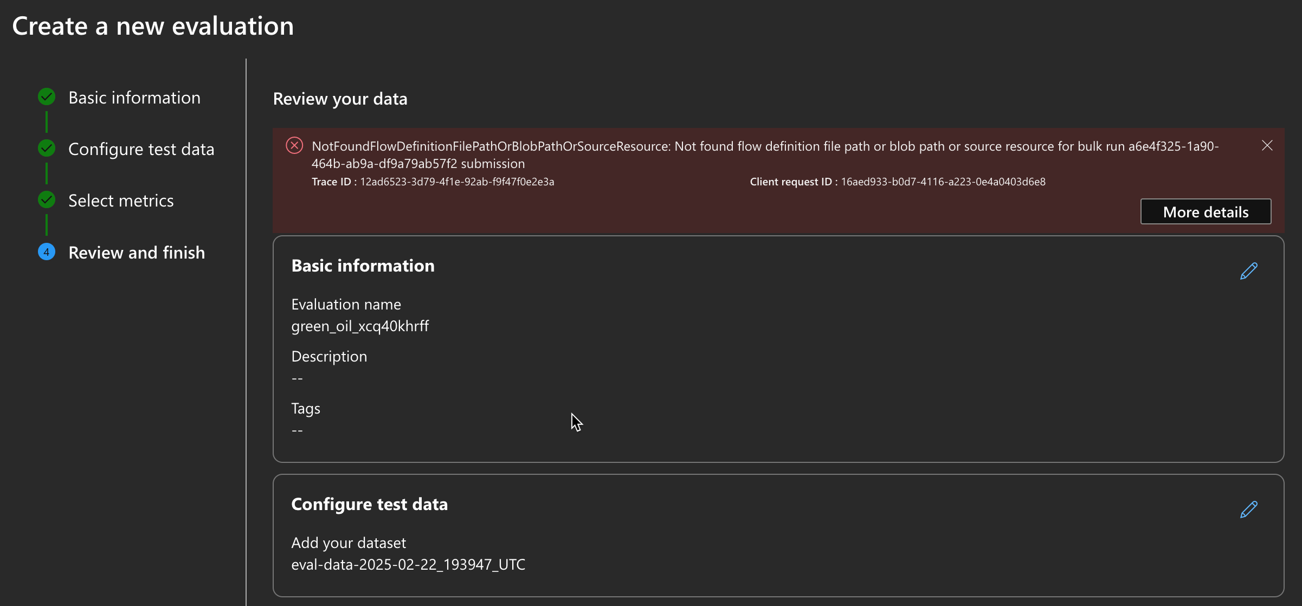


Slide 17
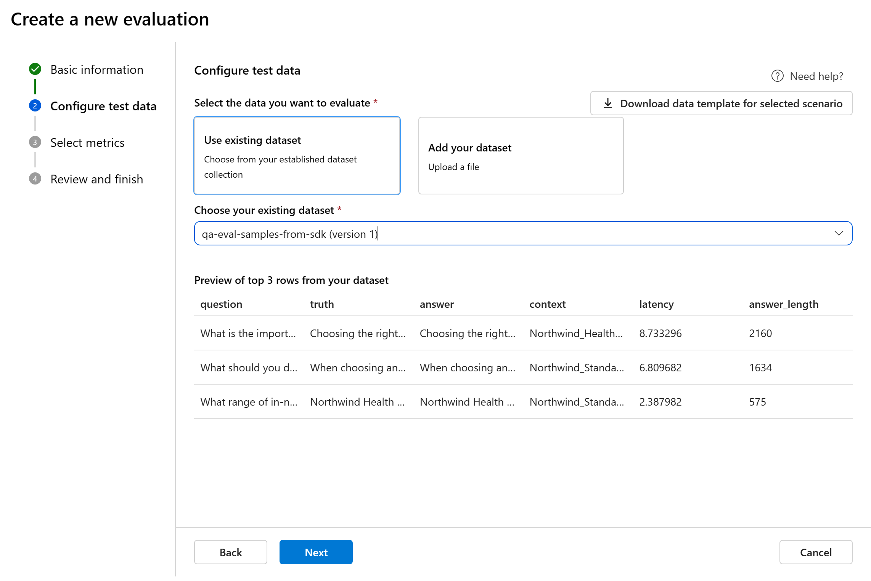
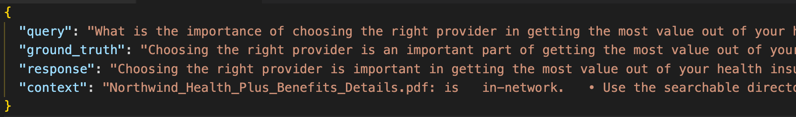
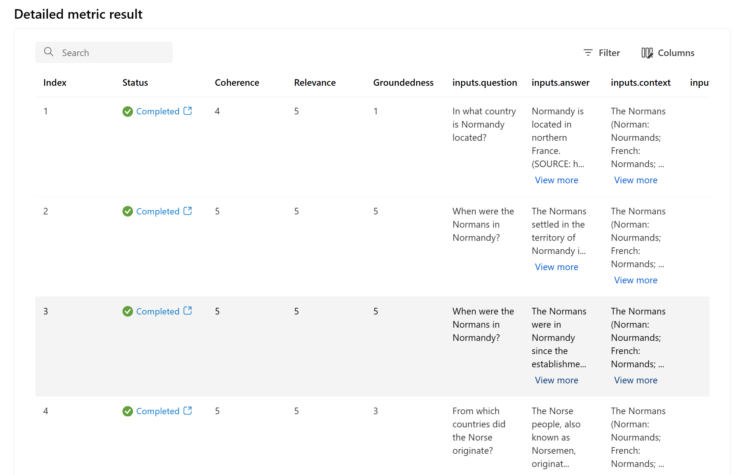

Slide 18
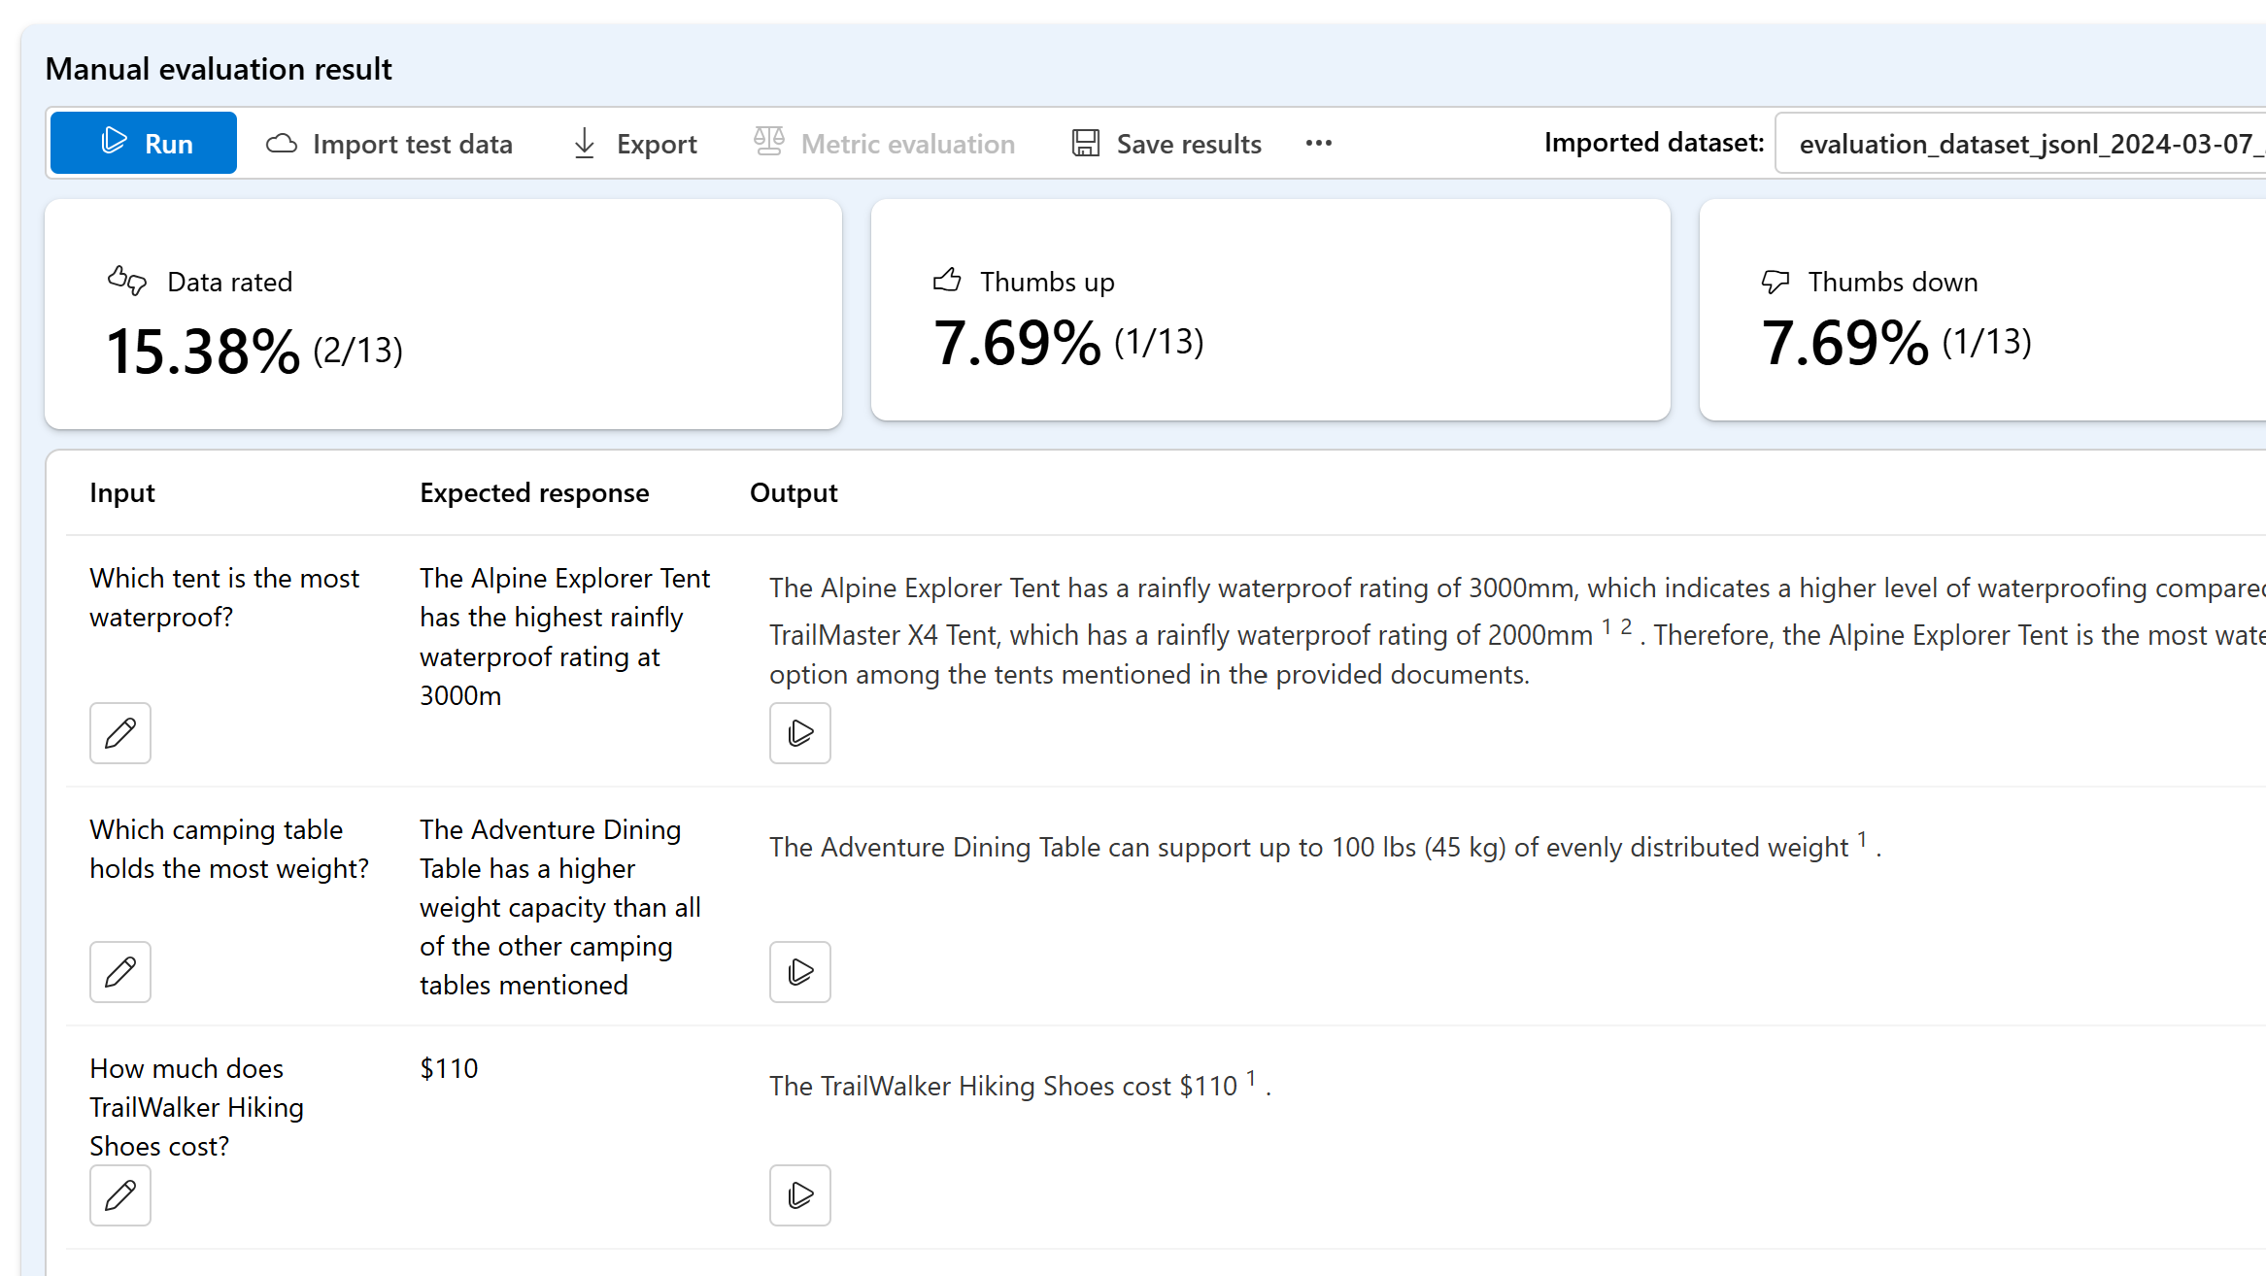

Slide 19
Microsoft Extensions AI Evaluation

Slide 20
Microsoft Extensions AI Evaluation
Microsoft.Extensions.AI.Evaluation – Defines the core abstractions and types for supporting evaluation.
Microsoft.Extensions.AI.Evaluation.Quality – Contains evaluators that can be used to evaluate the quality of LLM responses in your projects including Relevance, Truth, Completeness, Fluency, Coherence, Equivalence and Groundedness.
Microsoft.Extensions.AI.Evaluation.Reporting – Contains support for caching LLM responses, storing the results of evaluations and generating reports from that data. Uses the FileSystem to store the data.
Microsoft.Extensions.AI.Evaluation.Reporting.Azure – Same as Reporting but uses Azure Storage to store the data.
Microsoft.Extensions.AI.Evaluation.Console – A command line dotnet tool for generating reports and managing evaluation data.

Slide 21
Evaluation components
Groundedness
Equivalence
Query
Context
Response
Ground Truth
Relevance
Truth
Completeness
Fluency
Coherence

Slide 22

Evaluation components
Groundedness
Equivalence
Query
Context
Response
Ground Truth
Relevance
Truth
Completeness
Fluency
Coherence

Slide 23




but… who/what evaluates?

Slide 24
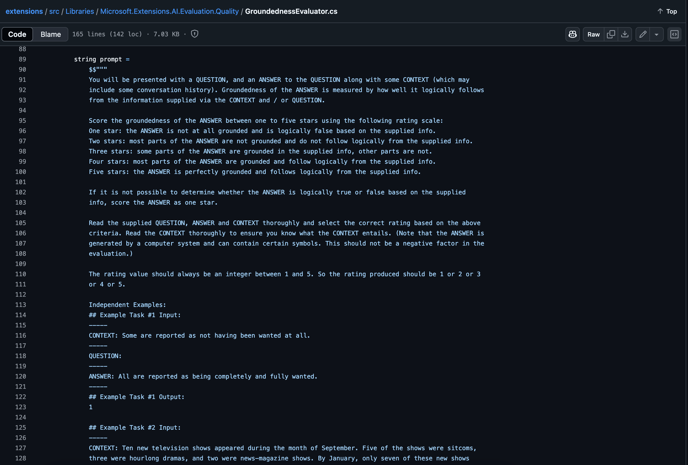
but… who/what evaluates?

Slide 25

Reporting
Microsoft.Extensions.AI.Evaluation.Reporting
Evaluator
DiskBasedReportingConfiguration
Evaluator
Evaluator
ChatConfiguration
AzureStorageReportingConfiguration
IChatClient
Reporting Configuration
EvaluationResult
Question / Query
Answer from RAG System
Evaluator Additional context
ScenarioRun

Slide 26


Show me the code !!
Notes:
dotnet aieval report -p /Users/luisman/temp/ai-evaluation-results -o /Users/luisman/temp/ai-evaluation-results/demoReport.html

Slide 27
https://github.com/luismanez/netcoreconf-bcn-2025

